Slide 1
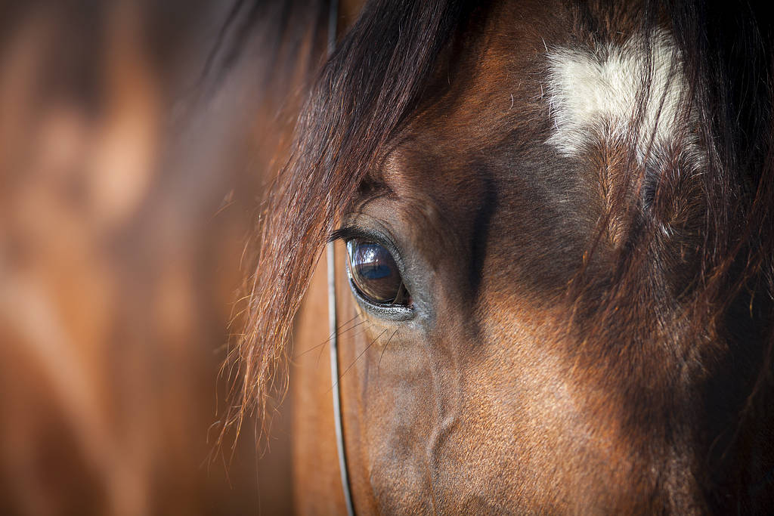
Equine Noise Anxiety Survey Results, UK & USA
Mirja Huhtinen, DVM, PhD
Animal Health Development Director
Orion Pharma

Slide 2


Summary
Reach
59 967
Clicks
2 379 (4%)
Respondents
1 220 (51%)
Target population
275 (22%)
Interest
(48%)
Reach
42 679
Clicks
1 455 (3%)
Respondents
605 (42%)
Target population
134 (22%)
(57%)
Interest
Main conclusion:
Noise reactivity is relatively common and interest for medical management strategy is high among the target population.

Slide 3
Survey Part I

Slide 4
Do you own a horse?
 | N | Percent
No | 34 | 2.79%
Yes, 1 horse | 678 | 55.57%
Yes, 2 horses | 294 | 24.1%
Yes, 3 or more horses | 214 | 17.54%
 | N | Percent
No | 17 | 2.81%
Yes, 1 horse | 250 | 41.32%
Yes, 2 horses | 149 | 24.63%
Yes, 3 or more horses | 189 | 31.24%

Slide 5
What is your experience with horses?
 | N | Percent
<2 years | 62 | 5.08%
2 – 5 years | 128 | 10.49%
6 – 20 years | 476 | 39.02%
>20 years | 554 | 45.41%
 | N | Percent
<2 years | 47 | 7.77%
2 – 5 years | 108 | 17.85%
6 – 20 years | 278 | 45.95%
>20 years | 172 | 28.43%

Slide 6
Has your horse ever shown any unusual behavior?
 | N | Percent
Yes | 275 | 22.41%
No | 952 | 77.59%
 | N | Percent
Yes | 134 | 22.04%
No | 474 | 77.96%

Slide 7
Survey Part II

Slide 8
Age
 | N | Percent
<1 year old | 1 | 0.37%
1 - 5 years old | 25 | 9.16%
6 - 15 years old | 166 | 60.8%
>15 years old | 81 | 29.67%
 | N | Percent
<1 year old | 0 | 0%
1 - 5 years old | 13 | 9.7%
6 - 15 years old | 76 | 56.72%
>15 years old | 45 | 33.58%

Slide 9
Sex
 | N | Percent
Mare | 107 | 39.19%
Stallion | 1 | 0.37%
Gelding | 165 | 60.44%
 | N | Percent
Mare | 57 | 42.54%
Stallion | 0 | 0%
Gelding | 77 | 57.46%

Slide 10
Please indicate the main purpose of your horse
 | N | Percent
Riding (show jumping/dressage/eventing) | 174 | 63.97%
Endurance | 4 | 1.47%
Western | 4 | 1.47%
Trekking | 27 | 9.93%
Harness racing | 0 | 0%
Breeding | 2 | 0.74%
Other, please specify: | 61 | 22.43%
 | N | Percent
Riding (show jumping/dressage/eventing) | 39 | 29.55%
Endurance | 2 | 1.51%
Western | 20 | 15.15%
Trail riding | 38 | 28.79%
Harness racing | 0 | 0%
Breeding | 1 | 0.76%
Other, please specify: | 32 | 24.24%

Slide 11
What is the best definition of the location of the property where your horse is kept?
 | N | Percent
Rural (surrounded by farms) | 136 | 49.82%
Semi-rural (adjacent to an urban area) | 114 | 41.76%
Urban (within a town/urban environment) | 14 | 5.13%
Other, please specify: | 9 | 3.29%
 | N | Percent
Rural (surrounded by farms) | 62 | 46.62%
Semi-rural (adjacent to an urban area) | 59 | 44.36%
Urban (within a town/urban environment) | 12 | 9.02%
Other, please specify: | 0 | 0%

Slide 12
What is the best definition of the property type where your horse is kept?
 | N | Percent
Farm | 91 | 33.33%
Small private stable | 123 | 45.06%
Equestrian centre/riding school | 34 | 12.45%
Racetrack | 0 | 0%
Other, please specify: | 25 | 9.16%
 | N | Percent
Farm | 42 | 31.82%
Small private barn | 60 | 45.45%
Equestrian center/riding school | 22 | 16.67%
Racetrack | 0 | 0%
Other, please specify: | 8 | 6.06%

Slide 13
Does somebody go and check on the horses during noisy events such as firework display?
 | N | Percent
Yes | 237 | 86.81%
No | 36 | 13.19%
 | N | Percent
Yes | 117 | 87.97%
No | 16 | 12.03%

Slide 14
How anxious would you rate your horse during noisy events?
 | N | Percent
Not anxious at all | 13 | 4.92%
Somewhat anxious | 160 | 60.61%
Very anxious | 70 | 26.52%
Terrified | 21 | 7.95%
 | N | Percent
Not anxious at all | 0 | 0%
Somewhat anxious | 67 | 50.38%
Very anxious | 56 | 42.1%
Terrified | 10 | 7.52%

Slide 15
Which of the following behaviours has your horse shown during noisy events?

Slide 16
How long does anxious behaviour usually last?
 | N | Percent
The duration of the noisy event | 157 | 59.24%
Up to 2 hours after the noisy event ended | 66 | 24.91%
Until the next day or longer | 27 | 10.19%
I don’t know | 15 | 5.66%
 | N | Percent
The duration of the noisy event | 93 | 69.92%
Up to 2 hours after the noisy event ended | 31 | 23.31%
Until the next day or longer | 8 | 6.02%
I don’t know | 1 | 0.75%

Slide 17
Has the horse injured itself as a result of the reactions caused by the noisy event?
 | N | Percent
Yes | 46 | 17.42%
No | 218 | 82.58%
 | N | Percent
Yes | 18 | 13.53%
No | 115 | 86.47%

Slide 18
In your opinion, which are your horse’s three most alarming behaviours related to noise reactivity?

Slide 19
At what age did your horse start showing these signs?
 | N | Percent
<1 year of age | 15 | 5.66%
1 - 3 years | 44 | 16.6%
4 - 9 years | 77 | 29.06%
≥10 years | 30 | 11.32%
I don't know | 99 | 37.36%
 | N | Percent
<1 year of age | 8 | 6.01%
1 - 3 years | 20 | 15.04%
4 - 9 years | 30 | 22.56%
≥10 years | 14 | 10.53%
I don't know | 61 | 45.86%

Slide 20
Has your horse’s noise reactivity changed over time?
 | N | Percent
No, it’s the same | 121 | 46.01%
Better with time | 110 | 41.82%
Worse with time | 32 | 12.17%
 | N | Percent
No, it’s the same | 57 | 42.86%
Better with time | 64 | 48.12%
Worse with time | 12 | 9.02%

Slide 21
How often does your horse show signs of noise reactivity?
 | N | Percent
Once a week | 66 | 25.29%
Once a month | 40 | 15.32%
Few times a year | 120 | 45.98%
Once a year | 8 | 3.06%
Less than once a year | 21 | 8.05%
Never | 6 | 2.3%
 | N | Percent
Once a week | 39 | 29.77%
Once a month | 23 | 17.56%
Few times a year | 51 | 38.93%
Once a year | 9 | 6.87%
Less than once a year | 6 | 4.58%
Never | 3 | 2.29%

Slide 22
Management strategies

Slide 23
Have you used prescription medicines?
 | N | Percent
Prescription medicines | 35 | 27.56%
Pheromone products | 15 | 11.81%
Other over-the-counter products | 67 | 52.76%
Other products | 32 | 25.2%
 | N | Percent
Prescription medicines | 19 | 30.65%
Pheromone products | 5 | 8.06%
Other over-the-counter products | 26 | 41.94%
Other products | 18 | 29.03%

Slide 24
Last New Year’s Eve (Fourth of July) in your area, which is the best descriptor of how much fireworks was displayed?
 | N | Percent
Not at all | 10 | 3.89%
Only distant sounds | 64 | 24.91%
Moderately heard sounds and lights from the neighbourhood | 88 | 34.24%
Well heard sounds and lights close by the stable | 64 | 24.9%
Constant fireworks in the close vicinity to the stable | 31 | 12.06%
 | N | Percent
No sounds | 4 | 3.1%
Only distant sounds | 27 | 20.93%
Moderately heard sounds and lights from the neighbourhood | 44 | 34.11%
Clearly heard sounds and lights close to the barn | 30 | 23.26%
Constant fireworks in the close vicinity to the barn | 24 | 18.6%

Slide 25
How do you plan to manage your horse this coming New Year’s Eve (Fourth of July )

Slide 26
If there was a new oral prescription product for noise reactivity available, would you be interested in using it?
 | N | Percent
Yes, please describe why: | 38 | 15.45%
Likely yes, please describe why: | 81 | 32.93%
Likely no, please describe why: | 60 | 24.39%
No, please describe why: | 67 | 27.23%
 | N | Percent
Yes, please describe why: | 22 | 18.03%
Likely yes, please describe why: | 47 | 38.53%
Likely no, please describe why: | 33 | 27.05%
No, please describe why: | 20 | 16.39%

Slide 27
What oral form of medication would you prefer to give to your horse?
 | N | Percent
Paste | 78 | 33.19%
Tablets | 19 | 8.09%
Powder/granules | 91 | 38.72%
Oromucosal gel | 8 | 3.41%
Oral liquid/solution | 24 | 10.21%
Other, please specify: | 15 | 6.38%
 | N | Percent
Paste | 55 | 47.01%
Tablets | 8 | 6.84%
Powder/granules | 35 | 29.91%
Oromucosal gel | 4 | 3.42%
Oral liquid/solution | 5 | 4.27%
Other, please specify: | 10 | 8.55%

Slide 28
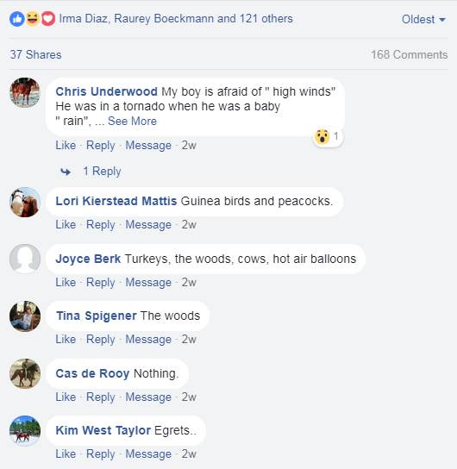
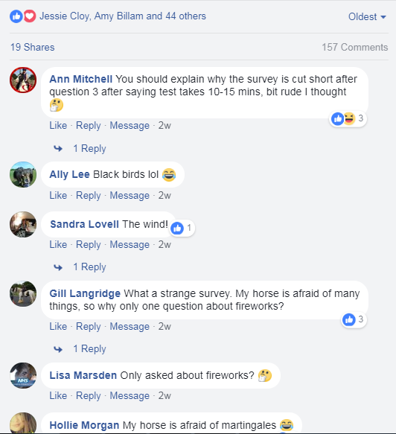
Comments

